Slide 1

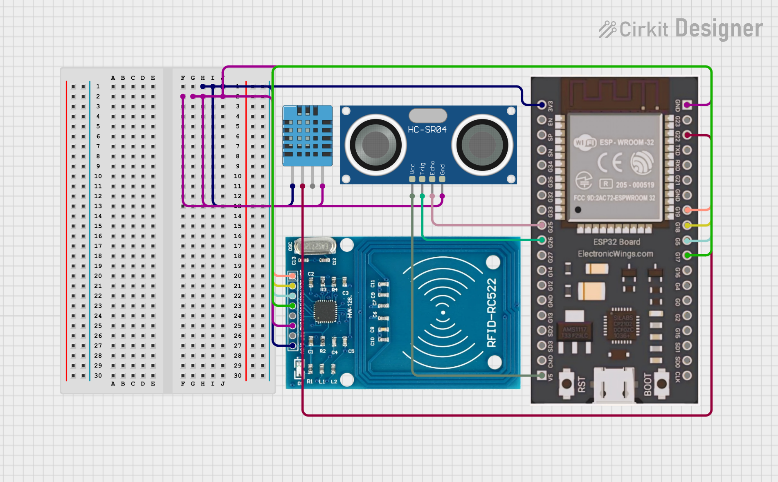
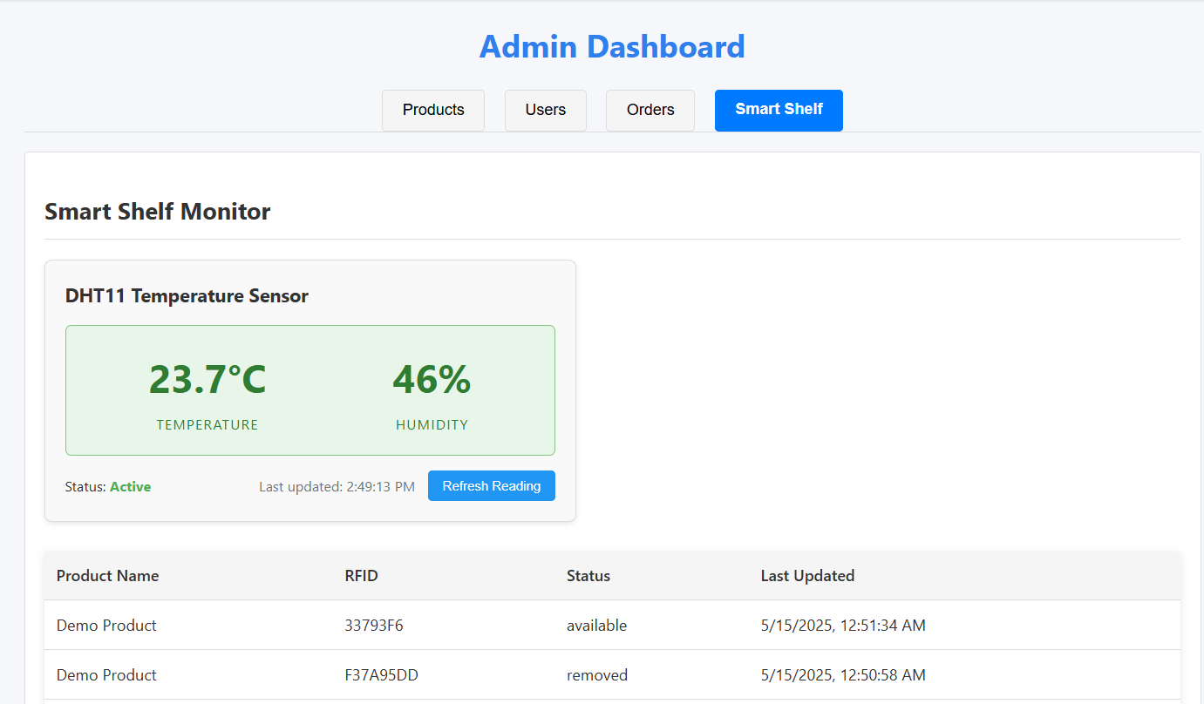

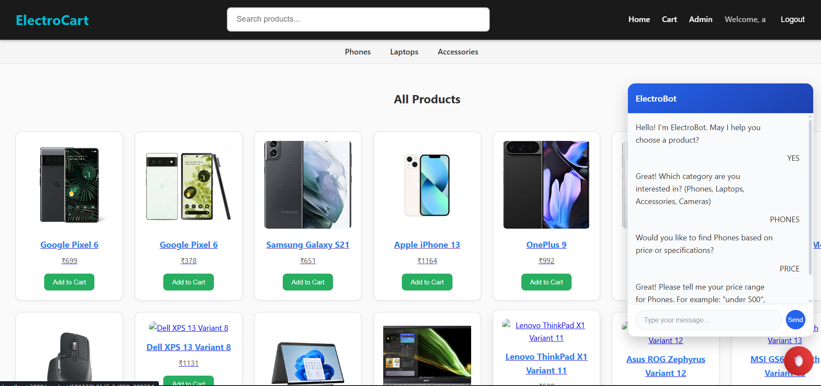
E-Commerce Platform with IoT Smart Shelf & Chatbot
INFORMATION TECHNOLOGY
SCHOOL OF ENGINEERING, ARCHITECTURE AND INTERIOR DESIGN
Abstract
This project presents a smart e-commerce platform integrated with an IoT-enabled shelf system to enable real-time inventory tracking and product environment monitoring. Built using the MERN stack and powered by sensors (RFID, Ultrasonic, and Temperature), the system allows customers to shop online seamlessly while providing admins live updates on stock status, product movement, and shelf temperature. It combines modern web development with embedded hardware to deliver a smart, secure, and efficient retail experience.
Smart Shelf Circuit Diagram
RESULTS
Smart Shelf Circuit Diagram
Results
Objectives
To develop a full-featured e-commerce web platform using the MERN stack (MongoDB, Express.js, React.js, Node.js).
To integrate an IoT-based smart shelf system using ESP32 and sensors for real-time inventory monitoring.
To ensure secure user authentication, cart operations, and payments using JWT and Stripe.
To provide real-time shelf data (product presence, RFID, and temperature) to the admin dashboard.
To enhance user experience through an AI-powered chatbot for product search and recommendations
Results
Conclusion
RESULTS
Conclusion
This project successfully integrates a modern e-commerce platform with an IoT-powered smart shelf to enhance inventory management, user experience, and operational efficiency. By combining web technologies with real-time sensor data, the system ensures accurate stock monitoring, environmental awareness, and intelligent automation — offering a practical solution for the future of digital retail.
Future Scope
Mobile App Integration for broader accessibility and real-time alerts.
AI-based Analytics to predict demand and optimize inventory.
Voice Assistant Support for hands-free user interaction.
Multiple Shelf Support for scalable warehouse or store deployments.
Smart Alerts for abnormal temperature or stock-out conditions
Methods
Future Scopes
Frontend: Built using React.js, JavaScript, and CSS. Used Axios for API calls, React Router DOM for navigation, and Stripe.js for secure payments.
Backend: Developed with Node.js and Express.js. Used MongoDB Atlas for cloud database, JWT for authentication, and bcryptjs for password security.
IoT Smart Shelf: Powered by ESP32 with RFID (MFRC522), Ultrasonic Sensor (HC-SR04), and DHT11 for temperature.
Programmed via Arduino IDE, sending real-time data to the backend over Wi-Fi.
Student’s Name – Mohammed Muhsin
Enrol No. – A92604922025
Program - BSc-IT, Semester 6
Batch -2022-2025
Dr Vinod Kumar Shukla Department of Information Technology
School of Architecture and Engineering, Interior Design
Amity University Dubai
Notes:
1st
Good morning to everyone present here. I’m Mohammed Muhsin, a final-year B.Sc. IT student from the Batch of 2022–2025. It’s a pleasure to present my major project titled:
‘E-Commerce Platform with IoT Smart Shelf and Chatbot for Live Inventory and Temperature Monitoring.’
This project brings together modern web technologies and IoT to build a smart, automated, and user-friendly e-commerce experience — both for customers and store administrators.
2nd
"The main objectives of my project are:
First, to build a feature-rich e-commerce website using the MERN stack, with secure user login, cart functionality, payments, and a chatbot to assist users with product search and recommendations.
Second, to develop an IoT-based smart shelf system using ESP32, sensors for real-time inventory and temperature monitoring.
And third, to integrate both systems so that the admin dashboard receives live shelf data — helping admins track product movement and shelf conditions automatically.“
3rd
“Here’s the tech stack used in my project.”
🔹 Frontend: Built with React.js, styled using CSS, with Axios for API calls and React Router for navigation.
🔹 Backend: Developed using Node.js and Express.js to handle APIs, authentication, and database interaction.
🔹 Database: Used MongoDB Atlas (cloud NoSQL) to store users, products, orders, and sensor data.
🔹 Security & Auth: Implemented JWT for secure login and bcryptjs to hash passwords.
🔹 Payments: Integrated Stripe for secure online payment processing.
🔹 IoT: Used ESP32 with RFID, Ultrasonic Sensor, and DHT11 to monitor shelf data and send it to the backend.
4rd
🧑‍💻 User Side: Seamless Shopping Experience Users can securely log in or register, then browse products by category (Phones, Laptops, Accessories) or use the search bar. A built-in AI chatbot assists in filtering and recommending products based on brand, price, and specifications. Users can add items to their cart, adjust quantities, and complete a secure checkout. After payment, an order confirmation is shown, and the order is processed.
🛠️ Admin Side: Full Control with Smart Shelf Monitoring Admins access a dedicated dashboard to manage users, products, and orders in real time. The dashboard also shows live data from smart shelves, including:
Product movement via RFID
Temperature and humidity data
Real-time availability status
Alerts with color codes: Green (Normal), Yellow (Warning), Red (Critical), along with timestamps This gives admins complete control and visibility for efficient management and restocking.
5th
🎯 Conclusion
“To conclude, this project successfully brings together a modern e-commerce platform with an IoT-enabled smart shelf system. It automates inventory monitoring, provides secure transactions, and improves user experience through features like an chatbot and real-time admin insights — making retail smarter and more efficient.”
🚀 Future Scope
“In the future, this system can be enhanced by adding push notifications for admins, predictive stock alerts using data analytics, multi-shelf support, and possibly deploying it on a larger scale for commercial use. We can also explore integration with mobile apps and voice-based assistants.”

